Slide 1


Slide 2

Real time Reddit Sentiment Analysis using Spark Streaming

Slide 3




Group 02 Team Members
u/Dhanraj Chinta
u/Daniel Injeti
u/Manisha Panigrahy
u/Mitali Vishwekar
KSMSCIT007
KSMSCIT011
KSMSCIT022
KSMSCIT039

Slide 4

r/What is Sentiment Analysis?
Study that aims to identify the orientation of opinions in a text
Sentiment analysis identifies emotions in text as positive, negative, or neutral.
Real-time sentiment analysis processes live data streams from social media, news, and customer feedback.

Slide 5
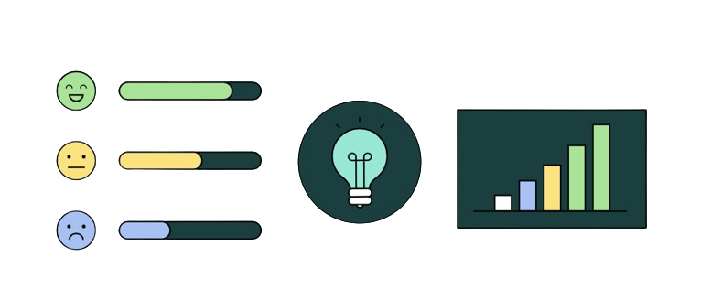
r/Why Did We Build This?
Reddit = Millions of Discussions But...What's the mood of these discussions? Is a topic trending positive, negative, or neutral?
We needed a tool that could analyze emotions at scale, in real-time!

Slide 6
r/The Power of Real-Time Sentiment Analysis
Instant Decision-Making
Unfiltered Public Opinion
Competitive Advantage
Data-Driven Strategies

Slide 7
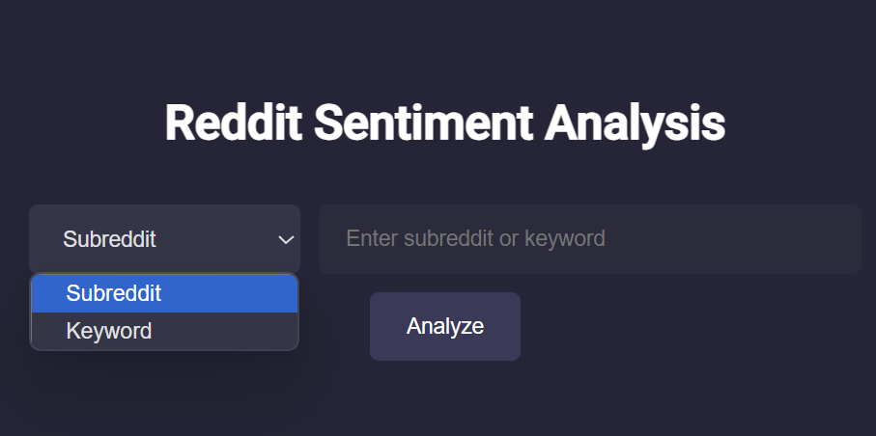
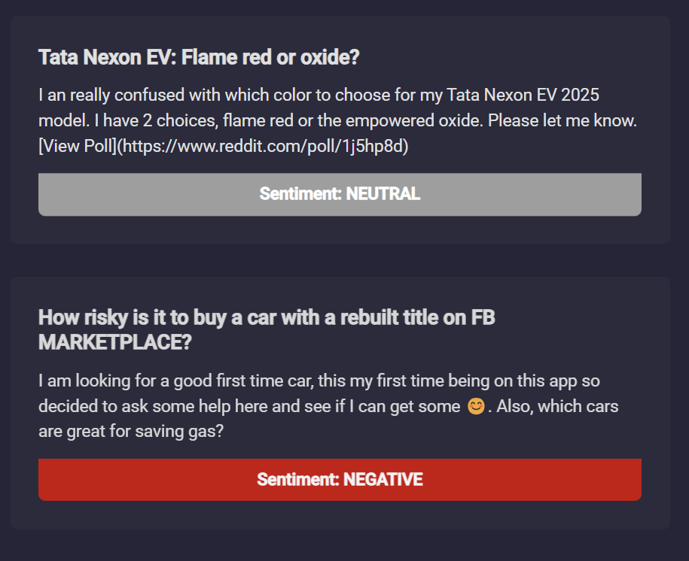
r/How It Works
User selects subreddit or keyword for analysis.
Fetches relevant Reddit posts using API/Scraping.
Processes posts in Spark Streaming for real-time sentiment classification.
Displays sentiment results (Positive, Neutral, Negative).

Slide 8




Speed & Performance
Fault Tolerance
Integration
Scalability
r/Why Spark for Real-Time Processing?

Slide 9
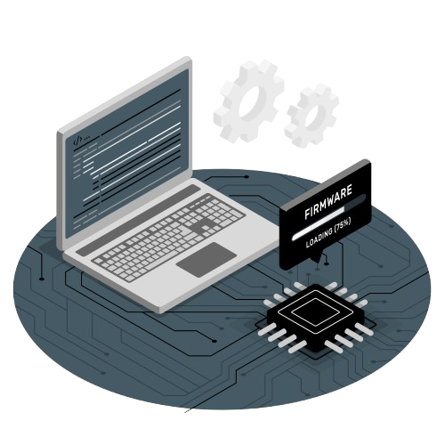
Framework : Django
APIs and Libraries : Praw Library
Backend: Python, Spark Streaming
NLP Model: VADER
r/What’s Under the Hood? [Tech Stack]

Slide 10
Practical Demonstrations

Slide 11

Meet our team members..
KSMSCIT007 Dhanraj Chinta
KSMSCIT011 Daniel Injeti
KSMSCIT022
Manisha Panigrahy
And that is it from our side…
Thankyou!
KSMSCIT 039
Mitali Vishwekar

